Slide 1
Predicting Student’s Success and Dropout Rates
By : Team 4 - Enigma

Slide 2



The Problem Predicting the success rate of a student whether he/she graduate college or dropout. | Methodology Using data science tools, we analyzed different statistical concepts and tried to predict the success rate of a student. | The Result Built several classification models including the likes of Random Forrest, SVC, Logistic Regression, KNN Classifier

Slide 3

Dataset Overview
What's inside? | Structured
Explore a dataset with 4424 observations and 36 variables | Our dataset is complete and carefully selected to ensure that you're working with the most relevant information.

Slide 4
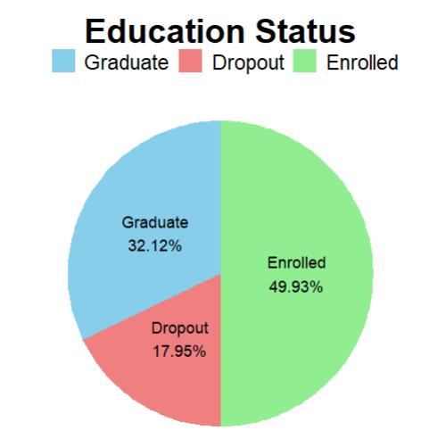
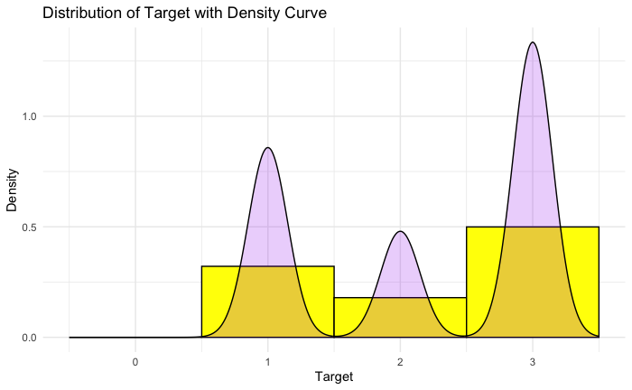
Dataset Distribution
1. Class Imbalance Awareness: The target variable plot reveals uneven distribution among its four classes (0, 1, 2, 3), emphasizing the need to address potential bias in machine learning models. Classes 0 and 3 appear less frequent than classes 1 and 2, potentially impacting model performance.
2. Enrollment Status Overview: The chart indicates that nearly half (49.93%) of individuals are currently enrolled, followed by graduates at 32.12%, and dropouts constitute the smallest portion at 17.95%.

Slide 5
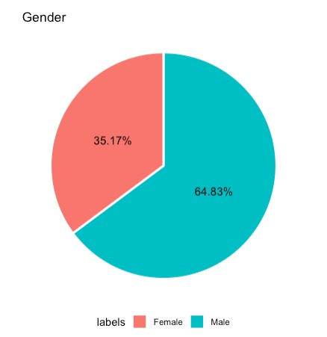
Gender Distribution
Males constitute a significant majority in the dataset, comprising 64.83% of the observations. This notable imbalance suggests that the dataset is skewed towards male representation.
While females make up a smaller proportion at 35.17%, their representation is still substantial. This diversity in gender is important for ensuring a comprehensive and inclusive analysis of the dataset.

Slide 6

SMART Questions
Does a student's average grade in their courses have any bearing on their decision to continue or discontinue their studies in the program?

Slide 7
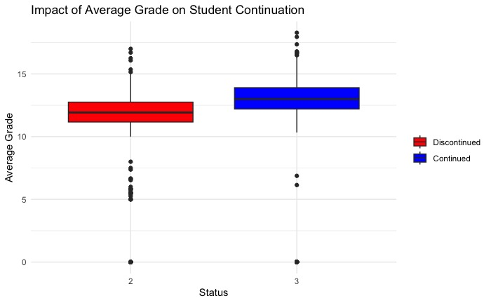
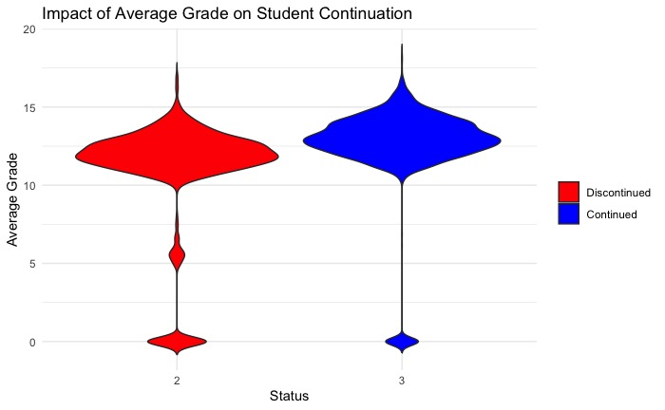
In examining the academic performance of students in the "Continued" and "Discontinued" groups, it becomes evident that the average grades for both groups are closely aligned and it does not appear to be a decisive factor in the students' determination to pursue further education or discontinue their academic journey.

Slide 8
SMART Questions
2. Can we identify trends in the timing of student dropouts within specific semesters, and what are the potential causes for these trends?

Slide 9
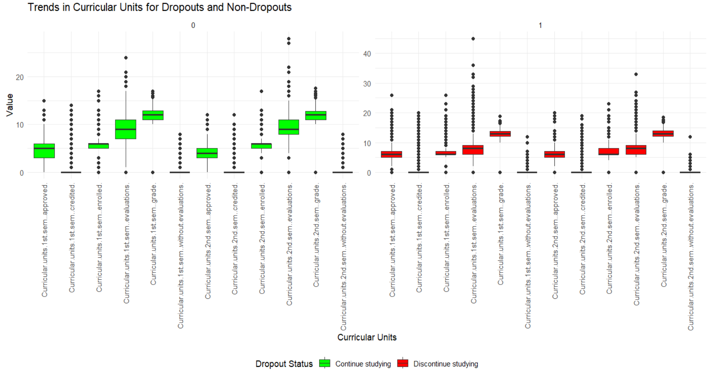
Continued students generally demonstrate higher academic performance, as indicated by consistently higher values across various curricular units.
Discontinuing students exhibit lower median values and increased variability, suggesting potential challenges or difficulties with coursework.

Slide 10
SMART Questions
3. Do factors related to socioeconomic status, like parent’s qualification or access to scholarships, play a role in affecting students' academic performance and completion rates?

Slide 11
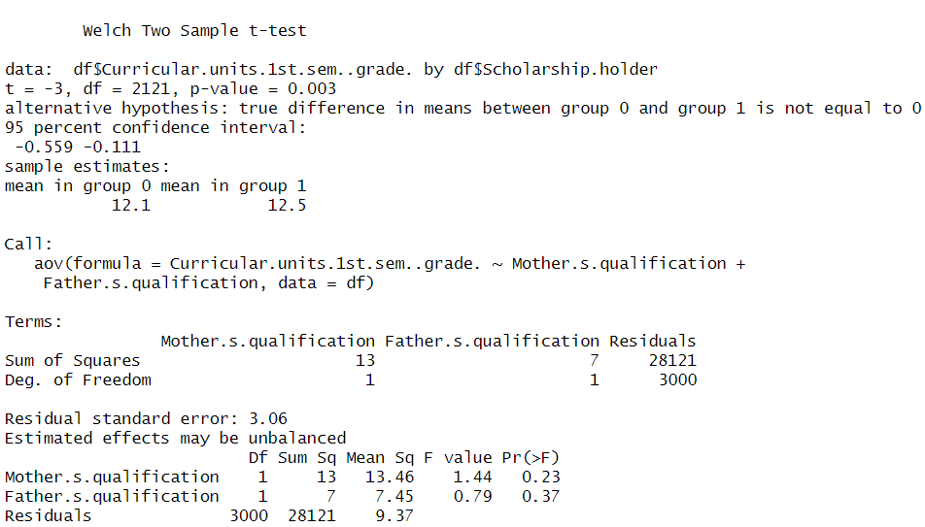
Solution
Two sample t-test suggests that students with scholarships tend to have a slightly higher mean academic performance compared to those without scholarships.
The ANOVA results suggest that both mothers' and fathers' qualifications does not have a significant impact on academic performance.
The p-value being greater than 0.05 suggests that this difference is statistically insignificant.

Slide 12
SMART Questions
4. Which demographic attributes, such as age, gender, or nationality, influence the academic success or failure more?

Slide 13
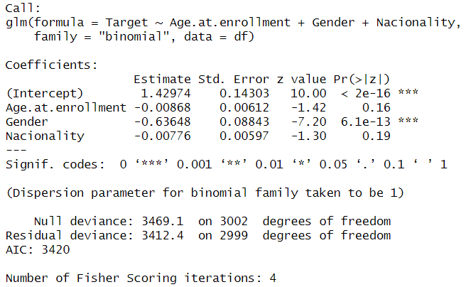
Solution

Slide 14
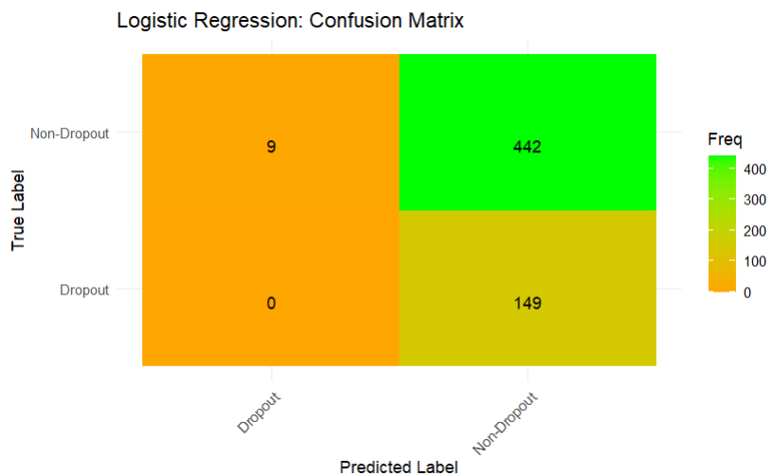
Logistic Regression
Precision: 74.8%
Recall: 98%
Accuracy: 73.7%
F1 Score: 84.8%
1. High Dropout Recall: Logistic regression excels with a 98% recall in identifying true dropouts.
2. Precision Insight: Precision at 74.8% signals a scope for improvement, revealing potential false positives.
3. Accuracy & Imbalance Impact: With 73.7% accuracy, the model's performance is influenced by class imbalance, especially in positive predictions.

Slide 15
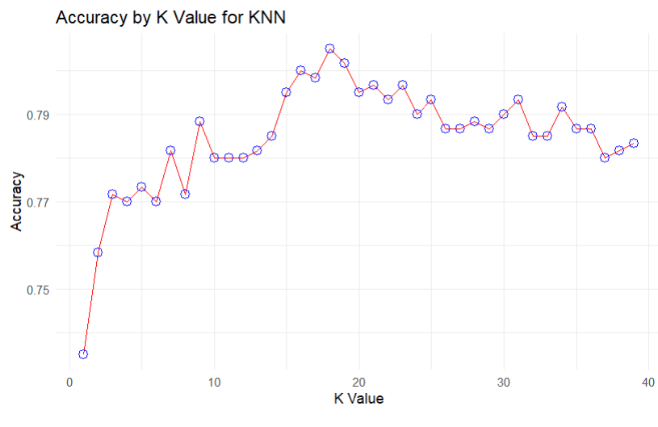
KNN Classifier
Precision: 80.8%
Recall: 93.6%
Accuracy: 78.5%
F1 Score: 86.7%
1. Balanced Precision/Recall: KNN achieves 80.8% precision and 93.6% recall, finding a solid balance.
2. Moderate Accuracy: With 78.5% accuracy and 32.9% sensitivity, there's room for precision improvement.
3. Imbalance Impact: Class distribution affects metrics, urging nuanced evaluation for imbalanced data challenges.

Slide 16
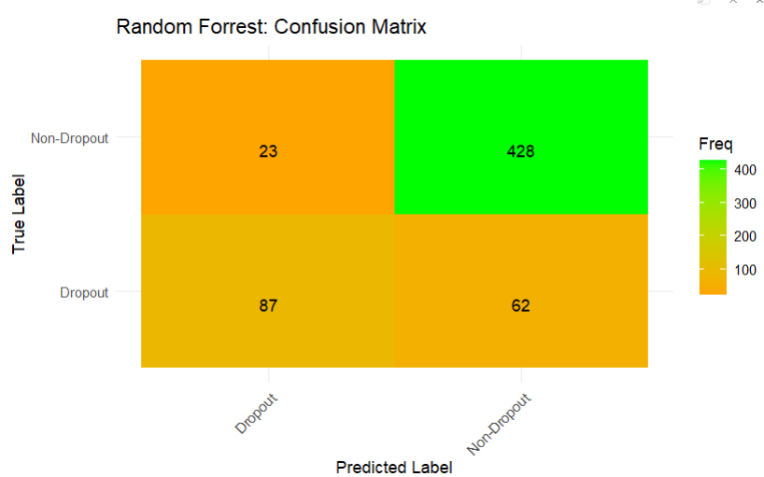
Random Forest
Precision: 87.3%
Recall: 94.9%
Accuracy: 85.8%
F1 Score: 91%
1. Precision and Recall: Random Forest excels with 87.3% precision and 94.9% recall, ensuring accurate identification.
2. Overall Accuracy: Achieving 85.8% accuracy, the model reliably predicts both dropout and non-dropout cases.
3. Balanced Metrics: With 76.6% balanced accuracy, it handles class imbalances adeptly.

Slide 17
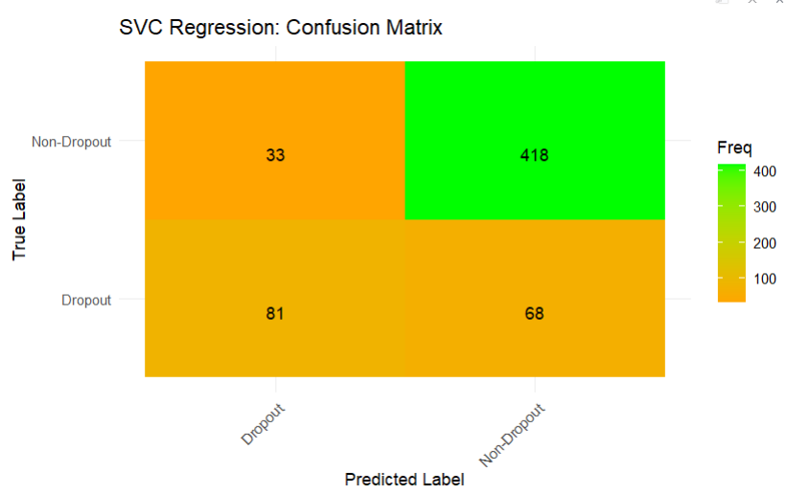
Support vector Classifier
Classification Metrics:
Precision: 92.7%
Recall: 86%
Accuracy: 83.2%
F1 Score: 89.2%
1. High Precision & Recall: SVC excels with 92.7% precision and 86% recall, showcasing accurate predictions.
2. Solid Accuracy: Achieving 83.2% accuracy, the SVC model proves reliable for binary classification.
3. Balanced Performance: With a balanced accuracy of 78.5%, the model handles imbalances well, ensuring robust predictions.

Slide 18

THANK YOU Aniruddha Vishnu Yash

